Slide 1

Harnessing EEG Signals with Deep Learning in Sports Biomechanics
Unlocking new frontiers in athletic performance and rehabilitation by analyzing brain activity with advanced AI.

Slide 2


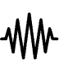

Why EEG Matters in Sports Biomechanics
Electroencephalography (EEG) offers a unique window into the brain's real-time involvement in athletic movement.
Real-Time Brain Activity
Rich Temporal Data
Overcoming Traditional Limits
EEG captures brain signals directly linked to motor control, movement intentions, and cognitive processes during physical exertion.
As a non-invasive method, EEG provides high temporal resolution data, revealing the precise neural patterns underlying complex athletic performance.
Previous EEG analysis often faced challenges with subjective interpretation and limited pattern recognition due to the complexity of brain signals.

Slide 3
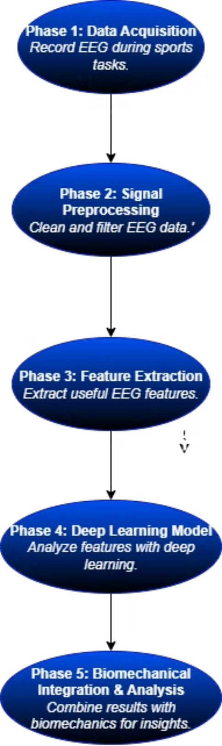
Workflow

Slide 4
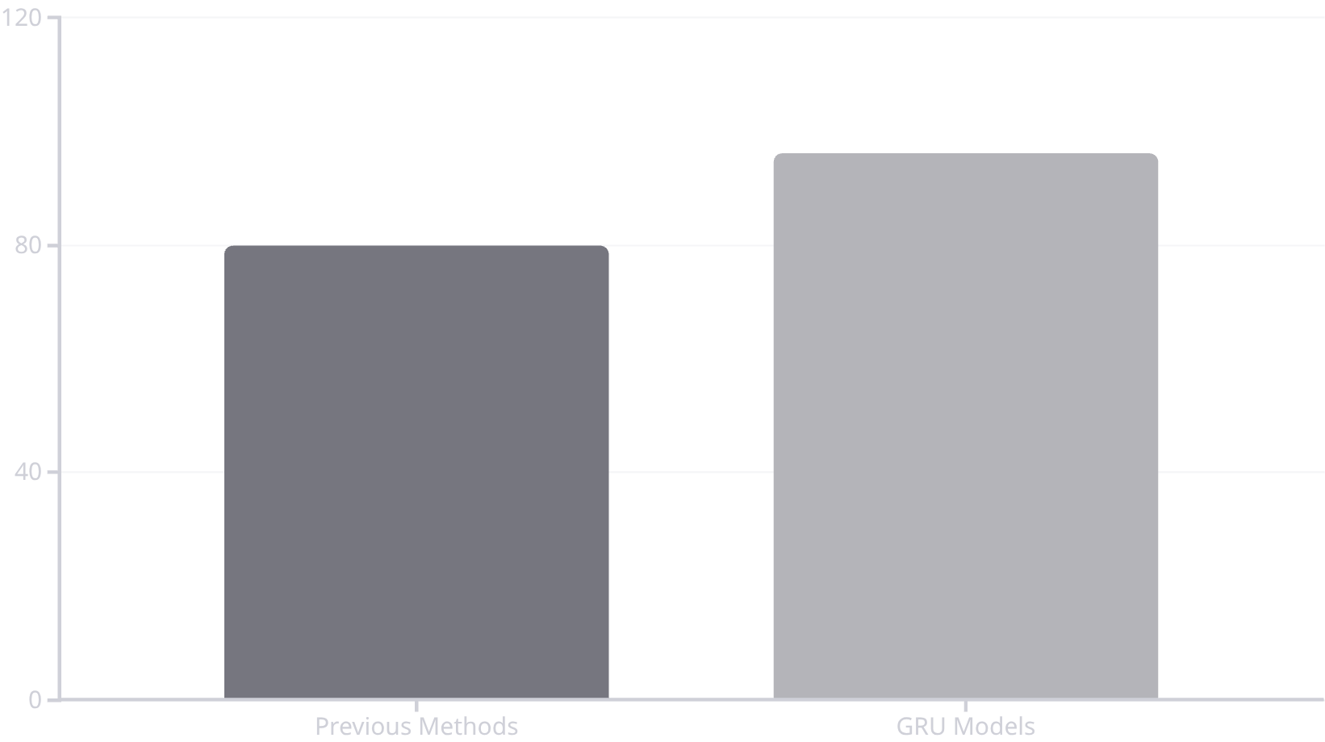
Breakthrough: Deep Learning Models Unlock Brain-Motion Insights
Advanced Deep Learning (DL) models are revolutionizing how we interpret complex EEG data, revealing hidden correlations between brain activity and specific movements.
Gated Recurrent Unit (GRU) networks are employed to analyze multi-channel EEG frequency data, ideal for sequential signal processing.
A study involving gymnasts and physical education students achieved motion recognition accuracy up to 99.15%.
GRU models significantly improved prediction accuracy by approximately 16% over conventional methods, enabling precise discrimination of athletic motions.

Slide 5



Real-World Impact & Applications
Integrating EEG with Deep Learning has profound implications for optimizing athletic training, injury prevention, and rehabilitation.
Advanced Motion Prediction
Exercise Rehabilitation
Wearable AI Systems
Provides crucial insights for rehabilitation by directly linking brain signals to movement quality and real-time fatigue detection.
Paves the way for integrated wearable EEG + AI systems to optimize training loads and monitor cognitive-motor integration.
Enables sophisticated prediction of athlete movements and assessment of posture control, enhancing performance analysis.

Slide 6

The Future of EEG & Deep Learning in Sports
Seamless integration with wearable biosensors and edge computing for real-time athlete monitoring.
Continuous expansion of datasets and refinement of AI models will lead to more precise and personalized performance analytics.
The synergy of EEG biomarkers and deep learning promises a new era of brain-informed sports science and advanced rehabilitation.

